Slide 1
Meet the Teacher

Slide 2
Thank you!
Thanks for working with us over the past week. I know its not easy, but it is in the best interest of your child.
Thanks for letting us into your homes.
Thanks for attending this evening.

Slide 3
Who will be looking after your child?
Mrs Varndell (Classroom teacher)
Mrs Howell (Classroom Assistant)
Notes:
Hello and welcome to meet the teacher. Yes, Mrs Varndell is still me. I was once Miss Southwell and over the summer holiday’s I thought it would be a good idea to get married, so my new name is Mrs Varndell.. Don’t worry, I am still getting used to it, so if I don’t respond, it’s because its still new to me. My wonderful teaching assistant is Mrs Howell who will support me and of course the children throughout the academic year. Myself and Mrs Howell have been working together for the last 3 years and have created a team which is a well-oiled cog, however, every year is different, and we adjust in the best interest of the child/children.

Slide 4
Who is Mrs Varndell
Woodlea is my third school.
I have taught reception for 8 years and Year 1 for 1 year.
I completed a 4 year university degree in Primary Education, specialising in Early Years.
My most famous line ‘I will figure it out’.
I am a good listener and of course when working with 4 and 5 year olds I have A LOT of patience.
Notes:
I have taught in three schools, each school offering different experiences and children, shaping and moulding to the teacher I am today. This will be my tenth year of teacher… I know…where has the time gone! Within Early years, you have to be flexible and work with the children to get the best possible results and thinking on your toes is essential, I am often sat at home reseaching dinosaur names, the latest princess, why does it rain and how to get playdough out of my clothes….. Hence my famous line… I will figure it out.

Slide 5
A day in the life of a reception child.
Reception gate will open between 8:30-8:50.
Drawing club
Explore and investigate
Guided reading
Explore and investigate
Phonics
Lunch
Maths
Explore and investigate/ outdoor learning
Story
Home time
Wednesday: Music Thursday: PPA/ Scarf Friday: PE and RE
Notes:
This is a typical day in a reception class, however, is subject to change. I will go into further detail about each session. PE will be on a Friday morning, your child can come to school in their PE kits. PE will start after October half term, we need to ensure the children are settled and in routines before we introduce PE.

Slide 6
Phonics
Phonics is taught daily
Phonics is a method for teaching children to read by linking together sounds (phonemes) (hat has three phonemes h-a-t) and the symbols we use to represent them (graphemes) (can consist of just one letter or a group of letters, and these have specific names. A grapheme that consists of two letters is called a digraph ‘sh’ ‘ch’, while one with three is called a trigraph ‘igh’ ‘ear’.
Any particular sounds that children are finding a challenge this will be address through linked provision, through play and regular flash of a card.
I will hold a phonic workshop Tuesday 30th September at 6pm.
Notes:
I highly recommend you attend this workshop as I will go through the sounds, provide resources and how best to support your child at home.

Slide 7
Reading
Your child will be heard three times a week through guided reading.
First read will be identifying the title, what it might be about and the skill of decoding the words.
Second read will be identifying prosody (expression)
Third read will be based around comprehension
Once the cycle of three reads in school is complete they will then take their guided reading book home.
Lastly, each child will take a book home for pleasure. A book from the library, this will happen Wednesday morning.
Notes:
Your child will be heard three times a week with an adult, this will take place on Monday, Wednesday, Thursday. By Thursday your child will be confident in reading their guided reading book and should be feeling proud and excited to share their reading skills and knowledge.
We will collect in all books the following Monday……… this will give you Thursday evening, Friday, Saturday and Sunday to read at home with your child.
It all sounds very confusing, however, once we start and get into routine it will become part of your weekly timetables.
Guided reading will start when the children have learnt some sounds and are beginning to segment and blend CVC words. I will not hand out books with words, until I am confident they are ready, as this will damage a child confidence and takes away the enjoyment of reading.
Each child will be given a yellow reading record, this is to be filled out each time you read with your child. This is important as it makes me aware of who needs additional reading time at school, if not being heard at school.

Slide 8
Maths
ELG: Number Children at the expected level of development will:
• Have a deep understanding of numbers to 10, including the composition of each number.
• Subitise (recognise quantities without counting) up to 5.
• Automatically recall (without reference to rhymes, counting or other aids) number bonds up to 5 (including subtraction facts) and some number bonds to 10, including double facts.
ELG: Numerical Patterns Children at the expected level of development will:
• Verbally count beyond 20, recognising the pattern of the counting system.
• Compare quantities up to 10 in different contexts, recognising when one quantity is greater than, less than or the same as the other quantity.
• Explore and represent patterns within numbers up to 10, including evens and odds, double facts and how quantities can be distributed equally.
Notes:
I just want to share with you the Early Years curriculum for Maths. I have provided you the curriculum, I just want to give you some time to digest and read. As you can see we only use numbers to 20. We verbally count to 20. Our role in EYFS is to ensure each child has a DEEP understanding of numbers to 10. Number bond facts are essential, alongside subertising. You maybe thinking ‘But my child already knows numbers 0-5’. White rose has developed a programme where a child embeds and deepens mathematical thinking and talking.
As teachers we will challenge and allow children to problem solve with numbers to 10, developing a mastery approach.
Maths is taught daily as a whole class
Maths is embedded within the provision

Slide 9
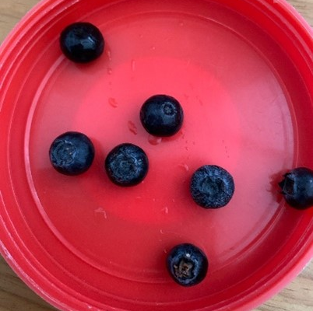
Subertising
Subitising is the ability to instantly recognise the number of objects in a small group without counting them.
For example:
Notes:
How many blueberries can you see? How do you know? What other numbers can you see?
Our aim is for each child to be fluent with their subertising as this is the foundations of number and will ensure a strong grasps of number patterns as they work through the school.

Slide 10
Drawing Club
Drawing Club, a literacy approach by Greg Bottrill, uses storytelling and drawing as a framework to develop early years skills through an engaging, play-based methodology. Its principles center on the 3M concept of making conversation, mark-making, and mathematics, while fostering vocabulary, imagination, and fine motor skills by engaging with a captivating text and allowing children to draw elements of the story and add their own innovative details like "secret symbols" and "passwords".
Notes:
Drawing club is amazing, every child enjoys it and looks forward to the sessions. Drawing club is a daily session at the beginning of the day. I will start by reading a story………. This is followed by vocabulary and actions which the children repeat and use within their story telling. They then draw a picture based on the theme… which is followed by a secret word and number.

Slide 11
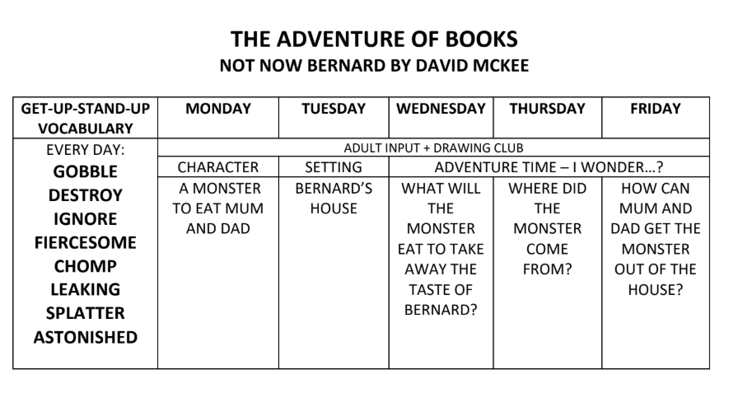

Slide 12
Explore and investigate. The importance of play.
Play underpins the EYFS. It also underpins learning and all aspects of children’s development. Through play, children develop language skills, their emotions and creativity, social and intellectual skills.
For most children their play is natural and spontaneous although some children may need extra help from adults.
Play takes place indoors and outdoors and it is in these different environments that children explore and discover their immediate world. It is here they practise new ideas and skills, they take risks, show imagination and solve problems on their own or with others.
Notes:
This speaks for itself. I am such an avocate for play and the importance of this enriching resource. Each day is different and the children lead the play, us adults facilitate this by prompting, suggesting and enhancing their play experiences.

Slide 13
SCARF
This will be taught by Mrs Howell on a Thursday afternoon.
SCARF PSHE is a whole-school curriculum resource developed by Coram Life Education to deliver Personal, Social, Health, and Economic (PSHE) education in primary schools. It stands for Safety, Caring, Achievement, Resilience, and Friendship, providing age-appropriate lesson plans, resources, and activities to help children develop life skills, build resilience, and promote their physical and mental wellbeing.

Slide 14
Biscuit Bear.
Biscuit bear, is my old teddy bear. She is well loved and has been on many adventures. Every child will spend a weekend with Biscuit.
The reason behind Biscuit bear, she will make appearances in unfamiliar places and environments which helps children relate to them. Seeing their own Biscuit in the classroom, and then seeing pictures of her adventures in faraway places helps children bridge the gap between the immediate, familiar environment and more abstract, unfamiliar environments.
Notes:
Biscuits will go in register order and will be given on Friday and back in on Monday, so your child can share their experiences through pictures, drawing and writing. Please feel free to email your photos into the office and we can print them out.
This brings me onto show and tell. This is show and tell, please do not bring in toys etc this avoids more resources in the classroom, a chance for them to get broken etc. The only show and tell aside from Biscuit bear is any outside achievements such as a sport award etc.

Slide 15
Communication
I will always be on the gate during drop off and pick up. This can be a time for discussions or to pencil in a meeting at a more convenient time.
We have the wonderful office staff who you can contact either by phone or email.
Whatsapp
Playdays. Really important. Children love them. Great way to boost confidence and form positive friendships.
Notes:
However, be mindful, they are very busy people and would greatly love a reduce in emails and phone calls. Please read everything they have sent you the information is there!!! If I feel there is a need to communicate after school with you, I will contact you and either prewarn a meeting after school or a phone call at a more convenient time. My door is always open and a I am friendly and approachable!!
Is there a Whatsapp group chat up and running? Who is the classroom reps?

Slide 16
Any Questions…………..

