Slide 1
2026 WOODLEA PTA AGM
Working Together
Overview

Slide 2
A Year of Collaboration & Community
The PTA continues to grow in its third year, driven by teamwork, fresh ideas and a focus on fun.
A huge thank you to the committee, volunteers and wider school community whose support makes every event possible.

Slide 3

Dedication from Elouise, our Secretary, to manage the administration and organisation which keeps us all on track
Strengthened financial processes and increased structure under Treasurer Mia, motivating the team to exceed the previous year’s income.
Second‑hand uniform and clothing collections tripled income, raising £1,000 – with thanks to Kiki and Elouise
Successful marketing led by Robyn and Laura ensured strong event attendance.
Our dedicated catering team who work hard to make delicious food for our events – Kiki, Dev, Karl and Robin.
The one and only Father Christmas
Jessi and Gareth who are always on hand to provide lighting and sound equipment and who made the SummerFest stage truly amazing.
Our Committee members who are always allows us to create the team approach - Charlie, Julia, Hayley, Michelle, Grace and Katty.
Special thank you for the contributions from the members that have recently left and will be missed – Helen, Kathleen and Clare.

Slide 4
New for 2025/26
New Christmas Grotto experience.
Laser Show.
World Cup Football Event.
SummerFest to end the year.
On-line second-hand uniform platform.
Increased number of clothing collection bringing in more funds.
Support from Woodlea parents to provide free equipment
Sponsorship money from local businesses to support events
Continued regularly payments from parents through companies.
Payments from a parent through an employee benefit scheme
Gift Aid registration - 25p back on every £1 for sponsored events (registered tax payers).
Parents in Action Day to provide extra hands to support school with jobs.

Slide 5
Everyone Can Make a Difference
Gift Aid Donations
Skills & Knowledge
We have started to ask people to consent on forms – can we push this in class groups.
25p to the PTA charity for every £1 donated.
Our Woodlea community has many talented people, please don’t be shy – let us know what you do and if you would like to get involved in projects and events.
Company Charity Donations
Volunteering
Can you get match funding for money you raise?
Do you have your own company and want to make charitable donations?
Does the company you work for offer donations to charities – we can do business cases, we just need to have contacts
Do you get volunteering days from work?
Can you help before and after events?
Can you give up time to source things for events?

Slide 6
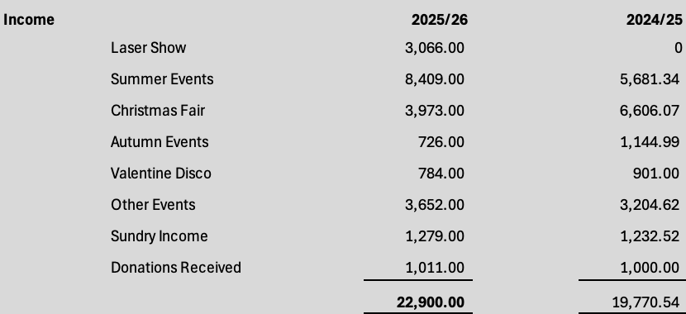
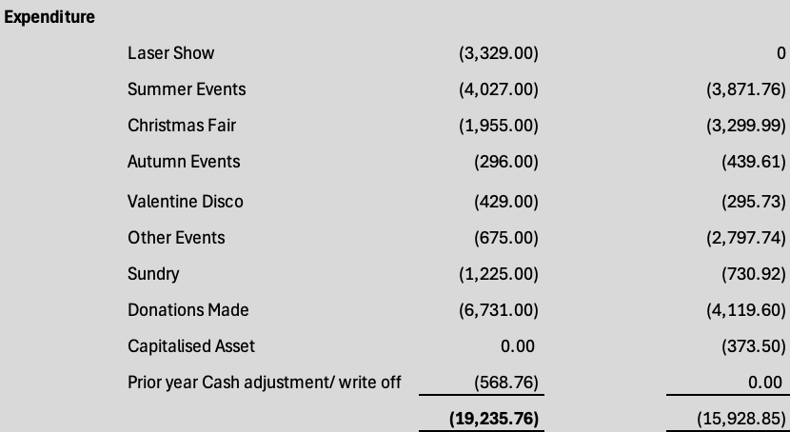
Woodlea Primary School PTA –
AGM Treasurer’s Report 2026
Key Highlights for 2025/26
Total income £22,900 (+16% vs prior year)
Total expenditure £19,236 (increase on prior year due to additional events and higher donations to the School of £6,731)
Net profit £3,664
£9,899 profit generated from events
Largest income generators:
Summer Fest £6,246 (+10% on prior year)
Christmas Fair £3,973
New events - Laser Show and World Cup Event raised income of £3,066 and £2,163 respectively
Also included in Other Events are the Colour Run & 2026 Class Challenge which raised a total of £2,655 showing continued success
Donations Received of over £1,000
Expenses:
Shed purchased for uniform sale and storage
Summer Fest stage and equipment expense is included in the 2026/27 accounts as it was paid post year end. Total Summer Fest profit including this expense was £1,814
The Petty Cash balance brought forward from 2024 (previous PTA) was written off in the year due to an unresolvable cash reconciliation. This is to ensure the correct Cash position going forward.
Restricted Funds: £1,000 brought and carried forward for Outbuilding Project
Prepared by PTA Treasurer Mia Woolnough. Income & Expenditure Statement – Year ended 31 August 2026

Slide 7

More support is resulting in more income

Slide 8

The Fundraising
01 September to 31 August

Slide 9

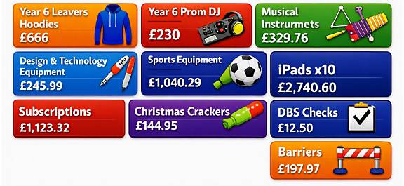
What have we funded during 2025/26
Total Funds Spent £6,731.28

Slide 10
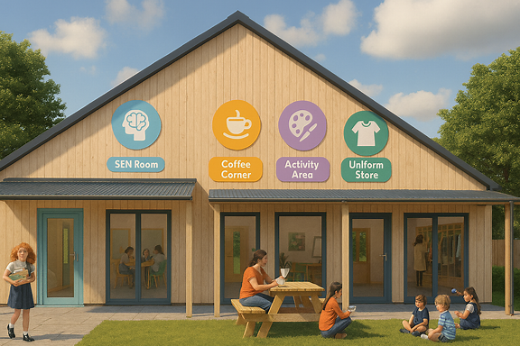

The Planned Spending for 2026 – 2027
Total Planned Spend
£5,329.32
Plans:
An Outbuilding (Extra Learning space, After School Clubs, Coffee Hut, Second-Hand Clothing Shop
Ring Fenced Money
£1,000 Donation
Lambs Welcome Gift
£165
Sports Activities
£2,000
Year 6 Leavers Hoodies
£666
Class Learning Resources
£1,000
Year 6 Prom Entertainment
£230
September 2026
PTA Bank:
£22,081.29
Anything else?
Plans:
Discussions around funding for air conditioning for classrooms
Christmas Crackers
£145
Subscriptons
£1,123.32

Slide 11










Subscriptions - Digital tools to support children’s learning, build confidence, and make lessons engaging and accessible for everyone.

Slide 12
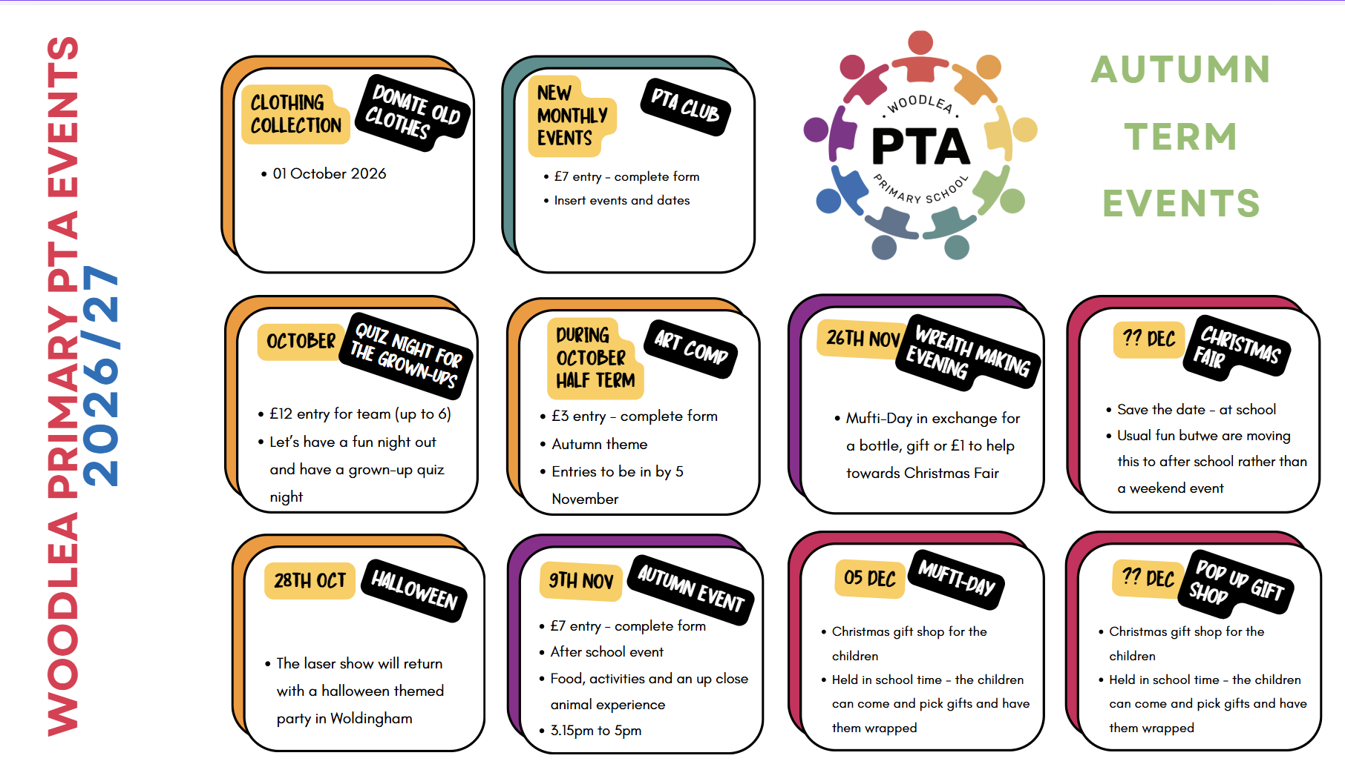
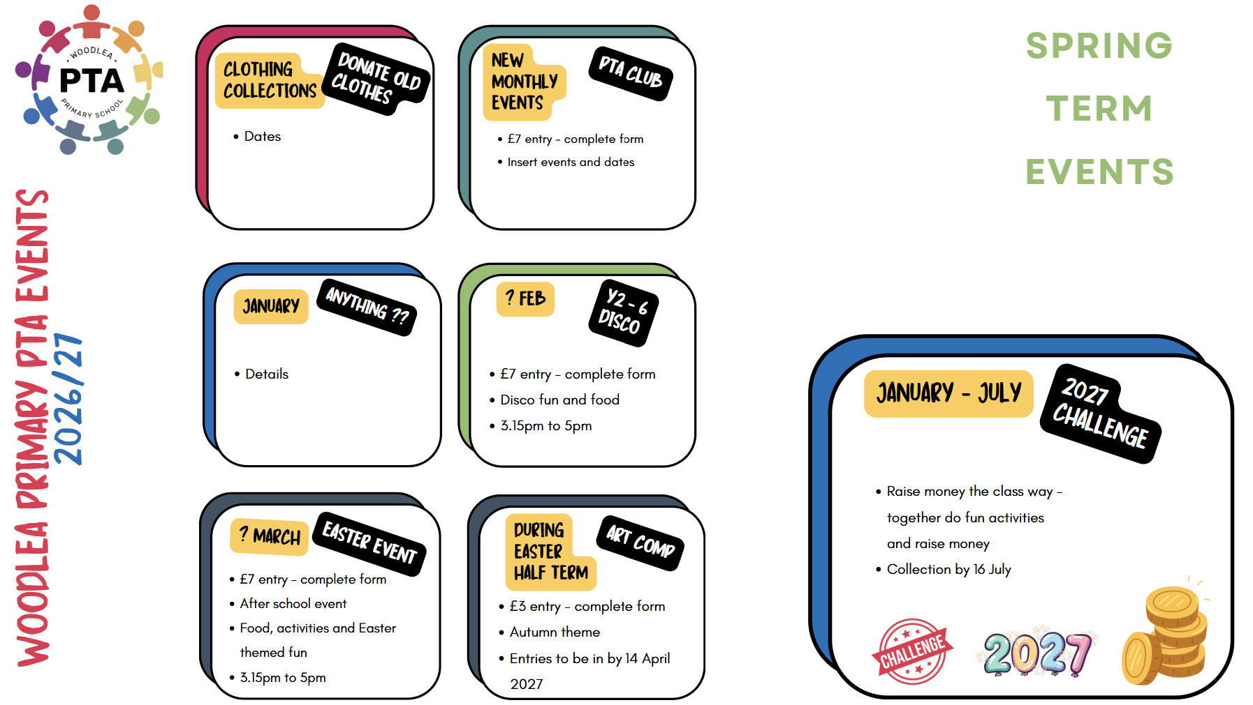
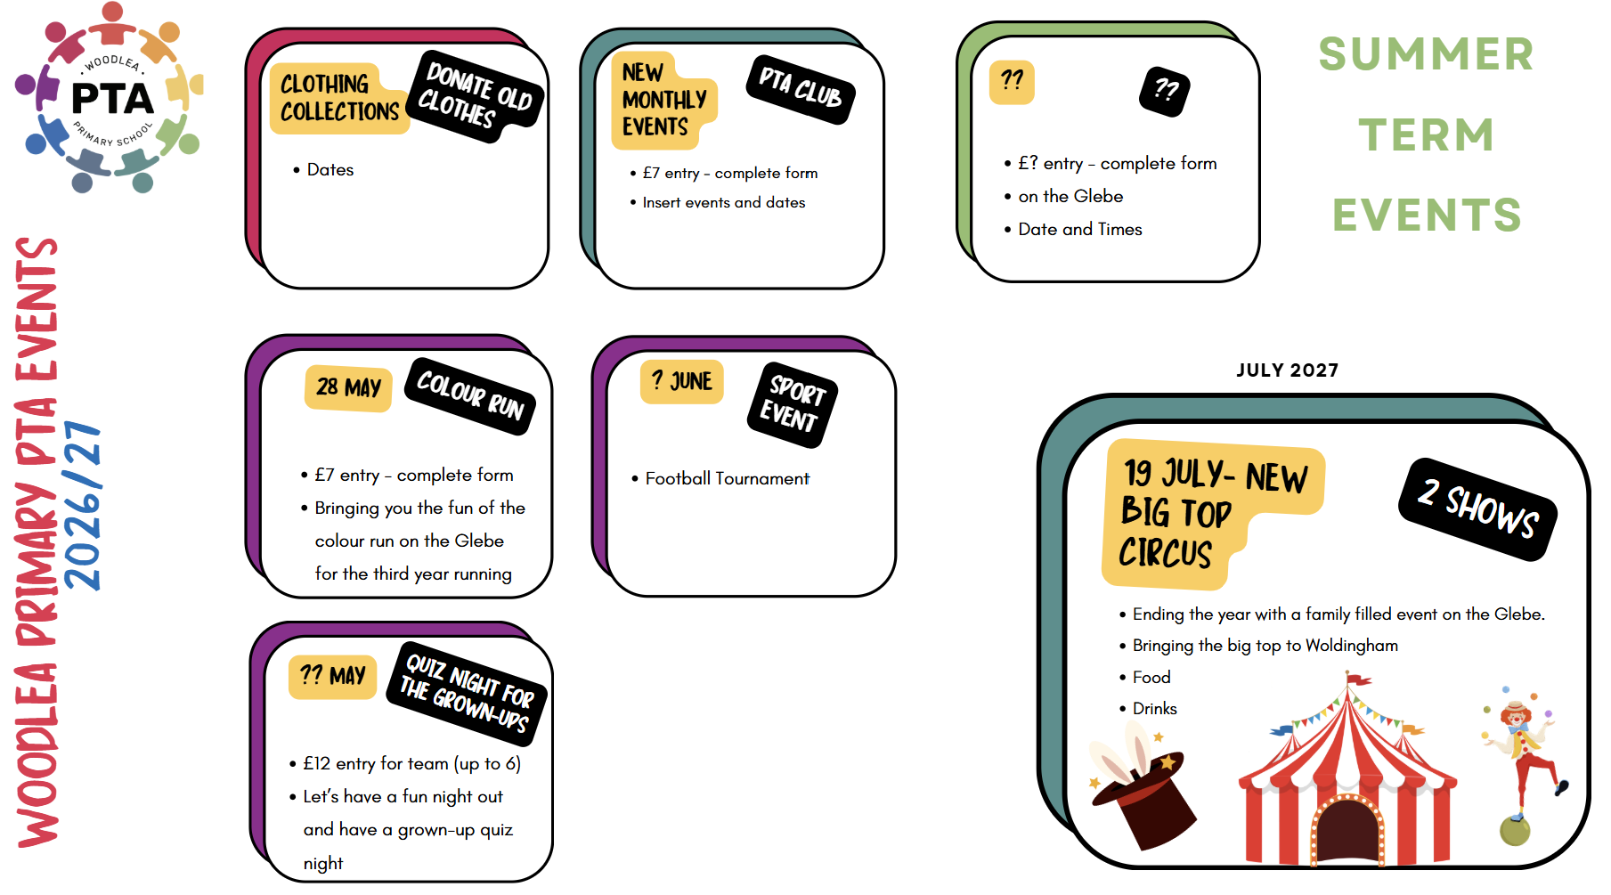
Looking Ahead – Proposed Plans

Slide 13


Thank you
We’ve had another great year working together to create fun events, memories and raise money to support the school. We do hope you will join in this year.

