Slide 1

Meet the Teacher
September 2026
.
Welcome back!
We are very excited to be welcoming your children into Year and are looking forward to a great year ahead

Slide 2

The Year 4 Team
Miss Scott-Clark- Class Teacher
Mrs King- Wednesday afternoon
Mrs M Gulless/Mrs J Caviglia

Slide 3

Our School Values

Slide 4
School Day
Timings
In the morning, gates open at 8:35am for a soft start. Pupils go straight into class.
Registers taken at 8:45. Finish Time: (3:15 R& KS1 / 3:20 KS2) in the playground.
Please be aware children on site before 8:30am must be accompanied by a parent/carer.
If attending Brambles or a club before school, parents must take the children to the location of the club.
If someone different is picking your child up or you are running late, please let the office know via email or the phone and they will pass the message on to us.
We are still putting in place the good practice we started during the pandemic. We encourage the children to maintain good personal hygiene e.g. sneezing into their elbow, washing/ sanitising hands regularly.
If your child is unwell and not fit to come to school, please let the office know as soon as possible.
Things the children need
  Uniform & bags – small rucksack/bookbag
  Outdoor shoes
  Water bottle
  DO NOT NEED – toys, notebooks etc.

Slide 5
Absence and Lateness procedures
Absence:
Parents are asked to inform the school of all absence on each day of absence by personal contact, letter, email or telephone.
Notification of the nature of the illness and the expected length of absence is also expected.
For medical or other appointments during the school day notification is required in advance, where possible these should be arranged out of school hours. Appointment cards/emails/texts must be shown to the school.
The office will make contact with the parent/carer of any child who is not in school for whom we have not received an absence message for by 9.15am.
Lateness:
Children who arrive late (after 8:50 but before 9:10) must report to the office.
If they arrive after 9:10 they should be accompanied by an adult to the office where they will be signed in.

Slide 6
Absence and Lateness
We understand that illness does occur, and events happen where you might run late, however the research is clear about the importance of attending school and being on time.
The pupils with the highest attainment at the end of key stage 2 and key stage 4 have higher rates of attendance over the key stage compared to those with the lowest attainment.

Slide 7
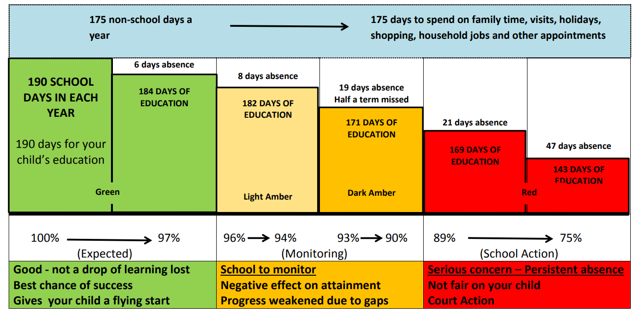

Slide 8
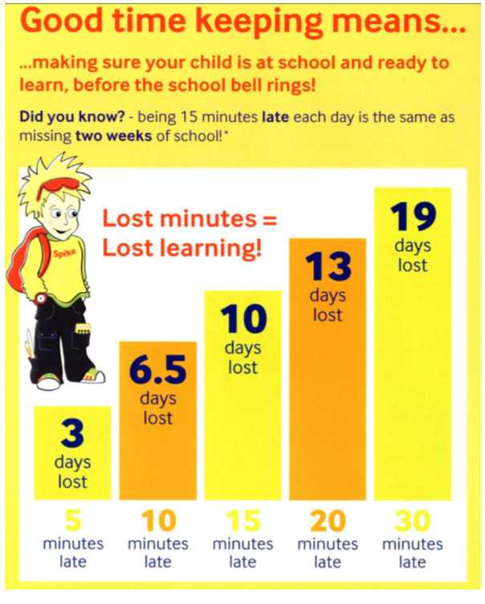
Being on time

Slide 9
Curriculum & Enrichment Activities
Woodlea Curriculum – Year Group Overview – Year 4
 | Autumn 1 | Autumn 2 | Spring 1 | Spring 2 | Summer 1 | Summer 2
Science | State of Matter | Sound | Electricity | Animals inc humans | Living things and their habitats | Summer Projects:
History | Anglo Saxons |  | Egyptians
Geography |  | UK |  |  | Earthquakes
Art & Design | Georgia O’Keeffe | Bridget Riley (UK) |  | Monochrome
Design & Technology |  |  | Shell structures using computer-aided design |  | Simple programming and control
Ready for Life | Finance | Zones of Regulation | First Aid | Cooking | Outdoor | Community
RE | What did God promise to his people? | What did Jesus say about God’s kingdom & why is it ‘good news’? | What are important times for Jewish people? | For Christians, is communion a celebration, or an act of remembrance? | How does ‘ibadah’ (worship) show what’s important to Muslims? | Are words more important than actions?
PSHE | Me and My Relationships | Valuing Differences | Keeping Myself Safe | Rights and Responsibilities | Being my Best | Growing and Changing
P.E | Personal (Gym) | Social | Cognitive (Dance) | Creative | Physical | Health and Fitness
Sport | Football | Hockey | Badminton | Cricket | High Jump | Sprinting/Relays
Computing | The Internet | Data Loggers | Programming | Photo Editing | Audio Editing | Repetition in Games
French | Tout autour de la ville | En mouvement | Faire du shopping | Où dans le monde ? | Quelle heure est-il ?! | Les vacances et les loisirs
Music | Musical structures | Exploring feelings when you play | Compose with your friends | Feelings through music | Expression and improvisation | The show must go on!

Slide 10
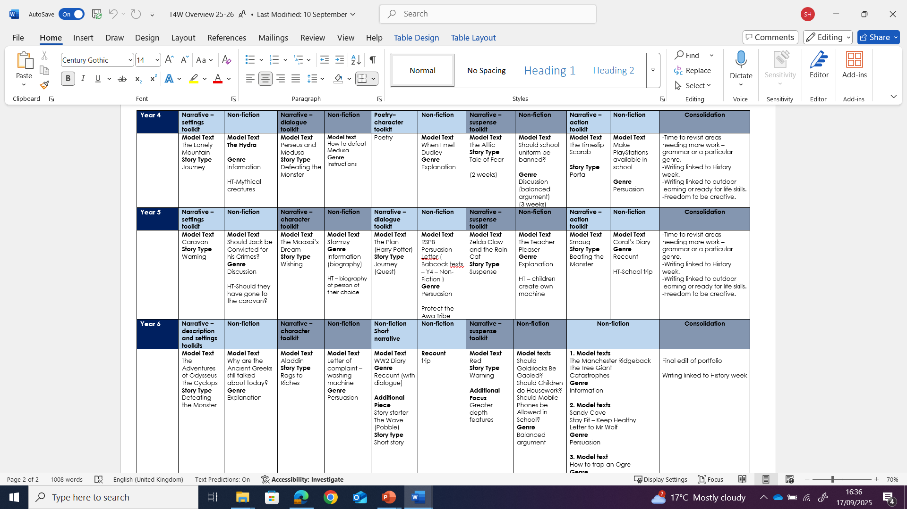
Writing

Slide 11
Writing

Slide 12

Curriculum & Enrichment Activities - Maths
Maths
We continue to follow the White Rose curriculum. In the Autumn term we are covering place value and addition and subtraction.
Multiplication check
This will take place in the summer term and will be done on a computer. Children will be asked a set of 25 random multiplication facts and will have 6 seconds to answer each question.

Slide 13
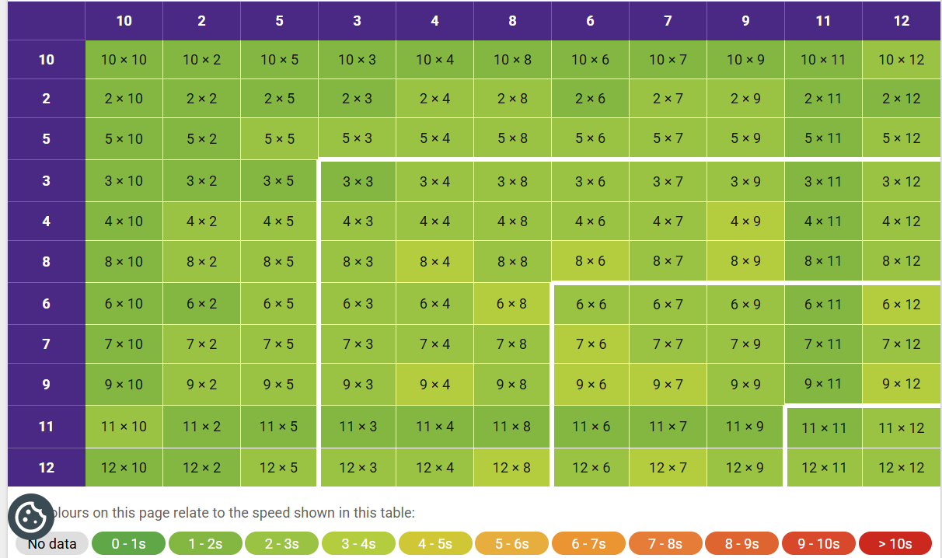

Slide 14



Curriculum & Enrichment Activities - Reading
Children should be reading for 20 minutes x4 a week.
The Children of Swallow Fell by Julia Green
Journey to the River Sea by Eva Ibbotson

Slide 15
Lily tiptoed into the empty library. Dusty books whispered on the shelves. She clutched a torn map tightly in her hands.
Retrieval question (answer is directly stated):
What was Lily holding in her hands?
Inference question (you must work it out):
How do you think Lily feels as she enters the library?

Slide 16


Slide 17
Curriculum & Enrichment Activities - Reading
Questions to help reading at home.
Before reading the book:
• Can you point to the title? Or what is this? (Pointing to the title)
• What do you think this story will be about? What might happen in the story?
• What do we call the writing on the back of the book? (Blurb) or What does the blurb tell us?
During the reading of the book:
• What is happening in the pictures?
• What has happened so far? Is it what you expected to happen?
• What might happen next? How do you think the story might end?
• What sort of character is….? Is he/she friendly/ mean/nice…?
At the end of the book:
• Did you like this book? Why? (Encourage children to develop their opinion about books by encouraging them to explain their reasons)
What was your favourite part? Why?
What was the most interesting/ exciting part of the book? Can you find it?
What sort of character was….?
Why did that character do … (give a situation/ event from the story)?
What happened in the story?

Slide 18
Curriculum – Guided Reading
Our guided reading sessions take place on Tuesdays. Children will be set homework on their book, and it must be brought back to school the following Tuesday to discuss with their peers.

Slide 19
Home Learning
Reading
Children should read for 20 minutes, four times a week.
Guided reading homework. (Tuesday)
Spelling
Spellings will be sent home with the guided reading books. Spelling will focus on the concepts taught that week, allowing children to practise these independently.
Maths / Times Tables
25 minutes per week.

Slide 20
PE & Outdoors clothing
PE is on Tuesday (outdoor) and Thursday (indoor)
These days will change through the year as we have coaches for different classes at different times in the year.
Clothing – Please ensure outdoor shoes can be put on independently and all clothing is labelled.
Earrings – none (If just had ears pierced and they can not be removed, they need to be taped up before school)

Slide 21

PHSE & RSE
We use SCARF - Safety, Caring, Achievement, Resilience, Friendship
6 themed units:
1. Me and My Relationships: includes content on feelings, emotions, conflict resolution and friendships;
2. Valuing Difference: a focus on respectful relationships and British values;
3. Keeping Myself Safe: looking at keeping ourselves healthy and safe
4. Rights and Responsibilities: learning about money, living the wider world and the environment;
5. Being My Best: developing skills in keeping healthy, developing a growth mindset (resilience), goal setting and achievement;
6. Growing and Changing: finding out about the human body, the changes that take place from birth to old age and being safe.
The whole curriculum, including the resources are available on our website: Woodlea Primary School - PSHE and RSE Curriculum
Before the summer units (RSE units) we send out specific information and invite parents into discuss the curriculum and ask questions
There will also be workshops for parent in the summer term.
Notes:
We know the news around this area can leave parents concerned. Everything we teach is carefully planned and was worked on through working parties with Woodlea parents in the past. We are completely transparent.
PSHE lessons are taught by their class teacher once a week in their timetabled PSHE lesson, throughout the entire year in their usual classes, in mixed sex groupings, using a range of interactive teaching methods, e.g. activity sheets, films, songs, online games, and drama techniques.
To ensure that children feel comfortable to learn about a range of topics, we create a safe learning environment using a group agreement at the beginning of lessons or topics. This includes a confidentiality statement understood by adults and children. The teachers will also use a range of skills, including distancing techniques and the anonymous question box. Teachers will answer children’s questions factually and honestly in an age-appropriate way and respond to any disclosures following the schools safeguarding procedures/child protection policy which can be found on our website.
Ref: School Policy download.asp

Slide 22
Fidget Tools (Learning Tools)
Fidget Tools can be useful for some children who might have additional needs to support their attention and engagement in class.
An agreement will need to be entered between child, parents and teacher to set out clear expectations of the use of fidgets in class.
This agreement will cover
How to use a fidget in class and when
What will happen if it is not used appropriately
Expectations of completing work and engagement in lessons
Fidgets will be provided by school and kept at school to ensure they are used appropriately
A discussion about the type of sensory tool being used
This agreement needs to be understood and signed by the child, parent and teacher to ensure fidget tools do not become the barrier to learning, but support.
Notes:
Emphasise just noticing increase in requests. Voluntary slide if you feel needed.

Slide 23
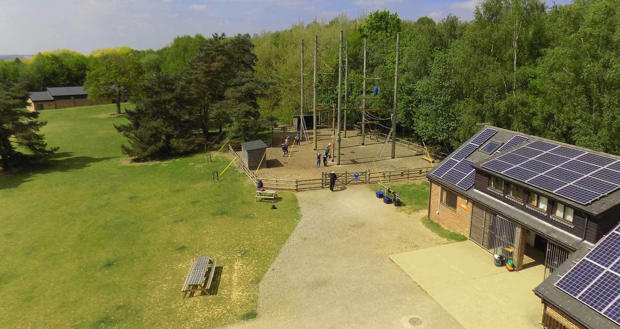
Carroty Wood
In Year 4 the children are lucky enough to have the opportunity to attend a residential trip to Carroty Wood for 3 days and two nights​
Carroty Wood is part of the Rock UK organisation and this specific location is just past Sevenoaks. ​
Wednesday 21st April- Friday 23rd April
There will be a separate Carroty Wood meeting next term

Slide 24
Curriculum days
Anglo-Saxon day Friday 13th November (Autumn 2)
Egyptian day Thursday 18th March (Spring 2)

Slide 25

Sponsored Walk – Monday 12th October
We are reviving a school tradition for raise funds but also explore the local area.
There will be three routes, one for Lambs (school grounds), and different ones for KS1 and KS2.
Children will be accompanied by school staff
We will be sending out letters with more info shortly.

Slide 26

Communication
If you have a concern / worry / question we are here to listen.
As you know you can just email the school office to arrange a time to chat in person with the member of staff or arrange a meeting via teams: info@woodleatlt.co.uk
This helps us to:
  give you/ your child the time and focus you need.
  do any investigation which might be needed.
First port of call is always the class teacher unless it is feedback or a wider school concern and then a member of the senior leadership team should be referenced.
Please do give us time to respond as we are all teaching during the day.

Slide 27
Any Questions?

