Slide 1


Meet the Teacher
September 2026
Welcome back!
We are very excited to be welcoming your children into Year 2 and are looking forward to a great year ahead.

Slide 2

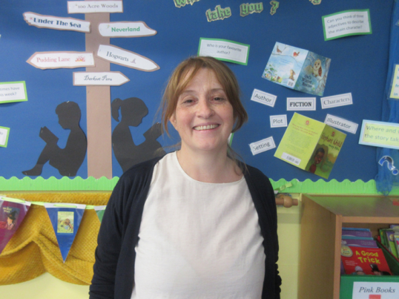
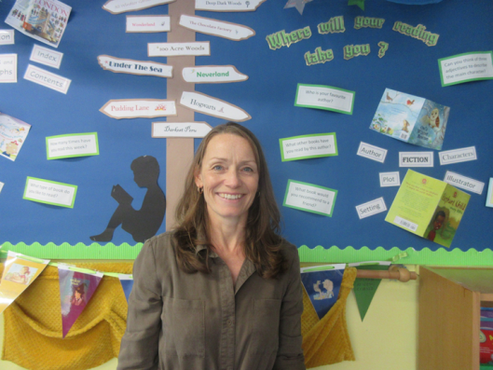
The Year 2 Team
Mrs Menham
Mrs Hill
Monday/Thursday/Friday Tuesday/Wednesday
Teaching Assistant: Miss Wasserfall

Slide 3

Our School Values

Slide 4
School Day
Timings
In the morning, gates open at 8:35am for a soft start. Pupils go straight into class.
Registers taken at 8:45. Finish Time: (3:15 R& KS1 / 3:20 KS2) in the playground.
Please be aware children on site before 8:30am must be accompanied by a parent/carer.
If attending Brambles or a club before school, parents must take the children to the location of the club.
If someone different is picking your child up or you are running late, please let the office know via email or the phone and they will pass the message on to us.
We are still putting in place the good practice we started during the pandemic. We encourage the children to maintain good personal hygiene e.g. sneezing into their elbow, washing/ sanitising hands regularly.
If your child is unwell and not fit to come to school, please let the office know as soon as possible.
Things the children need
  Uniform & bags – small rucksack/bookbag
  Outdoor shoes
  Water bottle
  DO NOT NEED – toys, notebooks etc.

Slide 5
Absence and Lateness procedures
Parents are asked to inform the school of all absence on each day of absence by personal contact, letter, email or telephone.
Notification of the nature of the illness and the expected length of absence is also expected.
For medical or other appointments during the school day notification is required in advance, where possible these should be arranged out of school hours. Appointment cards/emails/texts must be shown to the school.
The office will make contact with the parent/carer of any child who is not in school for whom we have not received an absence message for by 9.15am.
Lateness:
Children who arrive late (after 8:50 but before 9:10) must report to the office.
If they arrive after 9:10 they should be accompanied by an adult to the office where they will be signed in.

Slide 6
Absence and Lateness
We understand that illness does occur, and events happen where you might run late, however the research is clear about the importance of attending school and being on time.
The pupils with the highest attainment at the end of key stage 2 and key stage 4 have higher rates of attendance over the key stage compared to those with the lowest attainment.

Slide 7
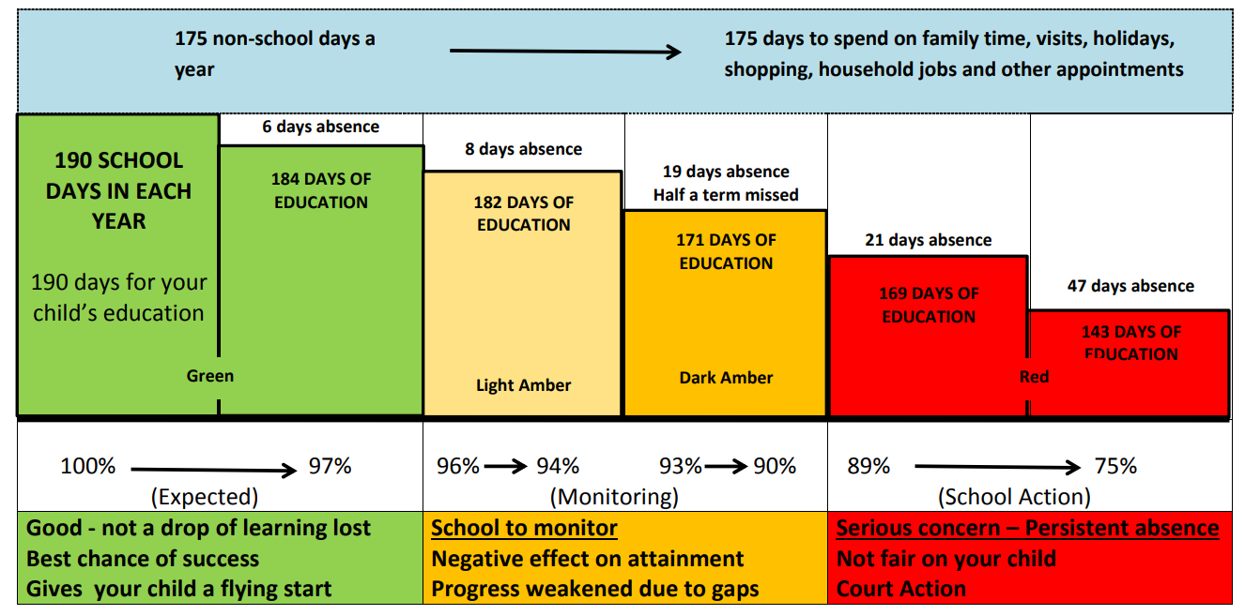

Slide 8
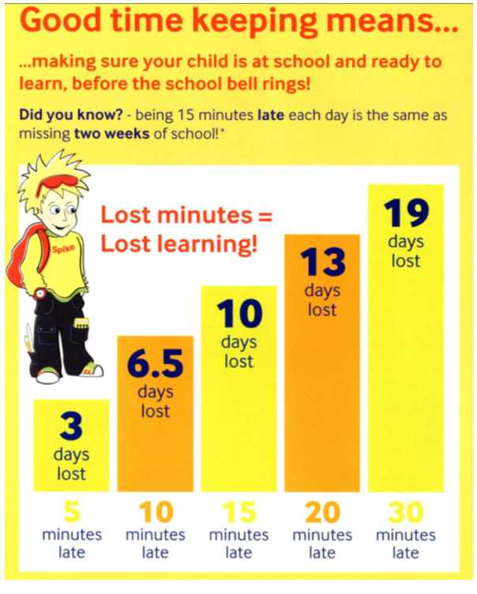
Being on time

Slide 9
EYFS/Key Stage 1 Timetable - Year 2
Year 2 | 8.45 | 8:55 | 9.20 | 9:30 | 10.25 | 10.35 | 10:55 – 11:55 | 11:55 – 12:55 | 12:55 – 1:20 | 1:20 – 2:20 | 2:20 – 3:15
Monday | Register | Reading | Mastering number | Maths | Whole-School Assembly | B | Writing | L | Phonics/ Spelling | Science | Computing
Tuesday | Register | Reading | Mastering number | Writing | KS1 Assembly (Singing?) | R | Maths | U | Phonics/ Guided Reading | Art | Music
Wednesday | Register | Reading | Mastering number | Maths | Whole-School Assembly | E | Writing | N | Phonics/ Spelling | RE | PE
Thursday | Register | Reading | Mastering number | Maths | KS1 Assembly Reading | A | Writing | C | Phonics/ Spelling | History/Geography | PE
Friday | Register | Reading | Mastering number | Writing | Whole-School Assembly | K | Maths | H | Phonics/ Guided Reading | Outdoor Learning | PSHE

Slide 10
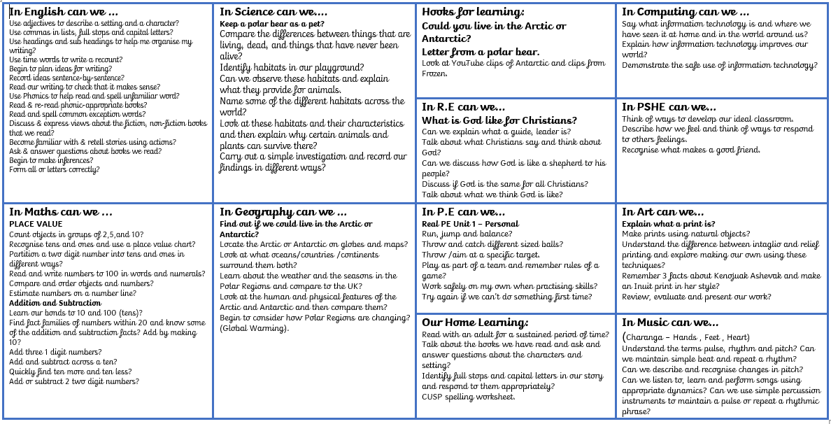
Autumn 1 – Year 2 2026

Slide 11
Curriculum & Enrichment Activities
Trips Usually in the Summer Term but we may possibly be able to do one in the Spring
Woodlea Curriculum – Year Group Overview – Year 2 2026
 | Autumn 1 | Autumn 2 | Spring 1 | Spring 2 | Summer 1 | Summer 2
Science | Living things and Habitats | Living things and Habitats | Materials | Materials | Animals including humans | Plants
History |  | Explorers |  | The Great Fire of London | Homes in the past
Geography | Could we live in the Arctic? |  | London
Art & Design | Inuit art and printing |  | Monet- London scenes |  | Still Life - Cezanne
Design & Technology |  | Templates and joining techniques- Puppets |  | Wheels and axles- Fire engines
Ready for Life | Zones of Regulation | First Aid | Finance | Community | Outdoor learning | Cooking
RE | What is God like for Christians? | Why is Giving important to Christians? | Why do Christians call Jesus Saviour? | Who is Allah and how do Muslims worship him? | What is important to Muslims? | Why should we look after our World?
PSHE | Me and my relationships | Valuing Differences | Keeping myself safe | Rights and responsibilities | Being my Best | Growing and changing
P.E (Real PE) | Personal | Social (Gym) | Cognitive | Creative | Physical (dance) | Health and Fitness
Sport | Football | Touch rugby | Badminton | Cricket | High Jump | Sprinting/relays
Computing | Information technology around us | Digital Photography | Robot algorithms | Pictograms | Making Music | Programming quizzes
Music | Pulse, pitch and rhythm | Playing in an Orchestra | Inventing a musical story | Recognising different sounds | Exploring improvisation | Our big Concert
-

Slide 12

PHSE & RSE
We use SCARF - Safety, Caring, Achievement, Resilience, Friendship
6 themed units:
1. Me and My Relationships: includes content on feelings, emotions, conflict resolution and friendships;
2. Valuing Difference: a focus on respectful relationships and British values;
3. Keeping Myself Safe: looking at keeping ourselves healthy and safe
4. Rights and Responsibilities: learning about money, living the wider world and the environment;
5. Being My Best: developing skills in keeping healthy, developing a growth mindset (resilience), goal setting and achievement;
6. Growing and Changing: finding out about the human body, the changes that take place from birth to old age and being safe.
The whole curriculum, including the resources are available on our website: Woodlea Primary School - PSHE and RSE Curriculum
Before the summer units (RSE units) we send out specific information and invite parents into discuss the curriculum and ask questions
There will also be workshops for parent in the summer term.
Notes:
We know the news around this area can leave parents concerned. Everything we teach is carefully planned and was worked on through working parties with Woodlea parents in the past. We are completely transparent.
PSHE lessons are taught by their class teacher once a week in their timetabled PSHE lesson, throughout the entire year in their usual classes, in mixed sex groupings, using a range of interactive teaching methods, e.g. activity sheets, films, songs, online games, and drama techniques.
To ensure that children feel comfortable to learn about a range of topics, we create a safe learning environment using a group agreement at the beginning of lessons or topics. This includes a confidentiality statement understood by adults and children. The teachers will also use a range of skills, including distancing techniques and the anonymous question box. Teachers will answer children’s questions factually and honestly in an age-appropriate way and respond to any disclosures following the schools safeguarding procedures/child protection policy which can be found on our website.
Ref: School Policy download.asp

Slide 13
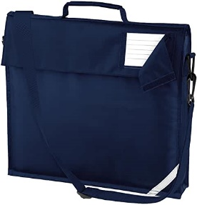

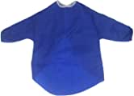
Equipment
Each child will need a named school bag for their reading book, spelling book and home-school reading diary.
They will also need a named water bottle. Please can water bottles have a ‘sip lid’ so that children do not need to take the lids off completely . All other equipment is provided by school.
All children will also need an art apron which will be kept in the classroom. This does not have to be a bought one, it can be an old shirt, T-shirt etc.
No-one will be stopped from participating in the lessons if they don’t have an overall, but we can’t promise they’ll stay clean!
Thank you for your
co-operation!

Slide 14
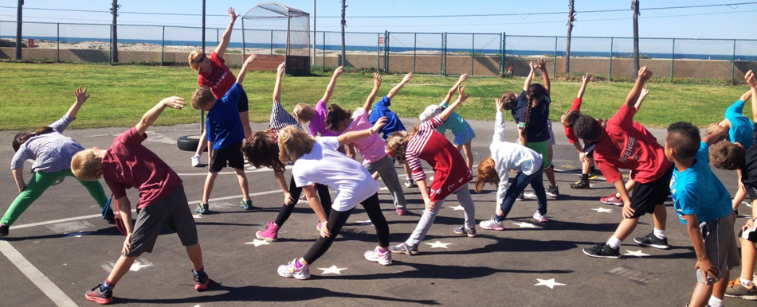
PE & Outdoors clothing
Days :Wednesdays and Thursdays
These days may change through the year as we have different coaches coming in.
Please can you ensure that children have a sweatshirt / jogging bottoms as the weather gets colder as these lessons will be outside whenever possible.
Children MUST have indoor and outdoor shoes on PE days….they cannot wear their outdoor trainers inside the building. Plimsolls should be kept in school for indoor PE sessions.
Earrings – none (If your child has just had ears pierced and they can not be removed, they need to be taped up before school)
Please make sure that all items of clothing are clearly named and your child can do their shoes up independently.

Slide 15
Home Learning
Daily reading
Weekly Spelling homework in line with CUSP.
Phonics practise
Number bond practise
Later in the year times tables practise.
Please use Numbots for number practise and later in the year TT Rockstars for tables.
Please use Lexia to support reading and phonics.
There may also be occasional topic-based activities to complete.

Slide 16
Reading
Individual reading is the main homework and as such, the expectation is for each child to read with an adult a minimum of 5 times a week.
Your child will have the opportunity to change their reading book every morning when they come into class. Obviously as they start reading chapter books and longer stories, they will need to keep the books for longer. Please let us know if they are not changing their book regularly - sometimes reluctant readers may try to bring the same one home on multiple days!
On Fridays, your child will bring home the group reading book that they have been working on that week. It is really important that these books are returned on Monday morning as another group will then be reading them.
Please could you record all the reading completed at home in the Home/School Reading Diary which will be checked by the teacher each Friday.
Over the first few weeks, as we assess the children’s reading and comprehension skills their book level may be quite fluid. At the end of the Key Stage, their assessment is based on their comprehension skills so if your child has not changed it may be that they are reading the text beautifully but are unable to answer questions/discuss the content. We really try not to focus on the ‘levels’ too much and instead ask children to focus on their own progress as it can get a bit competitive.

Slide 17
Curriculum & Enrichment Activities - Reading
Questions to help reading at home.
Before reading the book:
• Can you point to the title? Or what is this? (Pointing to the title)
• What do you think this story will be about? What might happen in the story?
• What do we call the writing on the back of the book? (Blurb) or What does the blurb tell us?
During the reading of the book:
• What is happening in the pictures?
• What has happened so far? Is it what you expected to happen?
• What might happen next? How do you think the story might end?
• What sort of character is….? Is he/she friendly/ mean/nice…?
At the end of the book:
• Did you like this book? Why? (Encourage children to develop their opinion about books by encouraging them to explain their reasons)
What was your favourite part? Why?
What was the most interesting/ exciting part of the book? Can you find it?
What sort of character was….?
Why did that character do … (give a situation/ event from the story)?
What happened in the story?

Slide 18
Fidget Tools
Fidget Tools can be useful for some children to support their attention and engagement in class.
A written agreement will need to be entered between child, parents and teacher to set out clear expectations of the use of fidgets in class.
This agreement will cover
How to use a fidget in class and when
What will happen if it is not used appropriately
Expectations of completing work and engagement in lessons
Fidgets will be provided by school and kept at school to ensure they are used appropriately
A discussion about the type of sensory tool will be
This agreement needs to be understood and signed by the child, parent and teacher to ensure fidget tools do not become the barrier to learning, but support.
Notes:
We know the news around this area can leave parents concerned. Everything we teach is carefully planned and was worked on through working parties with Woodlea parents in the past. We are completely transparent.
PSHE lessons are taught by their class teacher once a week in their timetabled PSHE lesson, throughout the entire year in their usual classes, in mixed sex groupings, using a range of interactive teaching methods, e.g. activity sheets, films, songs, online games, and drama techniques.
To ensure that children feel comfortable to learn about a range of topics, we create a safe learning environment using a group agreement at the beginning of lessons or topics. This includes a confidentiality statement understood by adults and children. The teachers will also use a range of skills, including distancing techniques and the anonymous question box. Teachers will answer children’s questions factually and honestly in an age-appropriate way and respond to any disclosures following the schools safeguarding procedures/child protection policy which can be found on our website.
Ref: School Policy download.asp

Slide 19

Sponsored Walk – Monday 12th October
We are reviving a school tradition to raise funds but also explore the local area.
There will be three routes, one for Lambs (school grounds), and different ones for KS1 and KS2.
Children will be accompanied by school staff
We will be sending out letters with more info shortly.

Slide 20
Questions and Queries
In Year 2 we have an ‘open door’.
Please be assured that we will answer any questions or concerns you have regarding your child’s school life as swiftly as possible.
Happy children learn best and as parents ourselves, we are very aware that any issue, however small it may seem, is best dealt with quickly so please do pop in to speak to us or get in touch via the office info@woodlea.surrey.sch.uk. if you have any concerns.

Slide 21

Communication
If you have a concern / worry / question we are here to listen.
As you know you can just email the school office to arrange a time to chat in person with the member of staff or arrange a meeting via teams: info@woodleatlt.co.uk
This helps us to:
  give you/ your child the time and focus you need.
  do any investigation which might be needed.
First port of call is always the class teacher unless it is feedback or a wider school concern and then a member of the senior leadership team should be referenced.
Please do give us time to respond as we are all teaching during the day.

