Slide 1
Meet the Teacher
Reception – Lambs Class

Slide 2
Who will be looking after your child?
Mrs Evans (Class Teacher – Monday, Tuesday and Wednesday)
Mrs Standing (Class Teacher – Thursday and Friday)
Miss Blakeney (Teaching Assistant)
Miss Gulless (Teaching Assistant)
Mrs Gregory (Teaching Assistant)
Notes:
Hello and welcome to meet the teacher. Yes, Mrs Varndell is still me. I was once Miss Southwell and over the summer holiday’s I thought it would be a good idea to get married, so my new name is Mrs Varndell.. Don’t worry, I am still getting used to it, so if I don’t respond, it’s because its still new to me. My wonderful teaching assistant is Mrs Howell who will support me and of course the children throughout the academic year. Myself and Mrs Howell have been working together for the last 3 years and have created a team which is a well-oiled cog, however, every year is different, and we adjust in the best interest of the child/children.

Slide 3
Who are we?
Experienced class teachers, both teaching for over 20 years
Experienced in leading Early Years in a number of schools
Assistant Heads at previous schools
Parents – girl mum and a boy mum
Notes:
I have taught in three schools, each school offering different experiences and children, shaping and moulding to the teacher I am today. This will be my tenth year of teacher… I know…where has the time gone! Within Early years, you have to be flexible and work with the children to get the best possible results and thinking on your toes is essential, I am often sat at home reseaching dinosaur names, the latest princess, why does it rain and how to get playdough out of my clothes….. Hence my famous line… I will figure it out.

Slide 4
A day in the life of a reception child
Reception gate will open between 8:35-8:50 a.m.
Throughout the day:
Discover and learn for child initiated continuous provision
Indoor/ outdoor provision
Snack / milk provided
Planned adult focus sessions:
Phonics
Drawing club
Guided reading
Maths
Topic based learning
Story
PE – Fridays starting next week
Home time:
3:15 p.m.
Notes:
This is a typical day in a reception class, however, is subject to change. I will go into further detail about each session. PE will be on a Friday morning, your child can come to school in their PE kits. PE will start after October half term, we need to ensure the children are settled and in routines before we introduce PE.

Slide 5
What does my child need?
Please bring in daily:
Waterbottle
Book bag
Coat (weather dependent)
Suncream and hat (weather dependent)
To keep in school:
Outdoor shoes / wellies
Spare clothes bag
Wear PE kit all day on PE days
NAME EVERYTHING!
Notes:
I have taught in three schools, each school offering different experiences and children, shaping and moulding to the teacher I am today. This will be my tenth year of teacher… I know…where has the time gone! Within Early years, you have to be flexible and work with the children to get the best possible results and thinking on your toes is essential, I am often sat at home reseaching dinosaur names, the latest princess, why does it rain and how to get playdough out of my clothes….. Hence my famous line… I will figure it out.

Slide 6
Phonics
Phonics is taught daily using Little Wandle Letters and Sounds.
Phonics is a method for teaching children to read and write by learning and linking sounds together.
Part of phonics is listening and attention including, rhyming, alliteration and oral blending and segmenting.
Any particular sounds that children are finding a challenge will be addressed through linked provision, play and regular focused teaching.
We will be holding a phonics workshop on Monday 28th September at 6 p.m.
Notes:
I highly recommend you attend this workshop as I will go through the sounds, provide resources and how best to support your child at home.

Slide 7
Reading
Group reading sessions will happened three times a week.
First read will be identifying the title, what it might be about and the skill of decoding the words.
Second read will focus on fluency and prosody (expression).
Third read will focus on comprehension.
Once the cycle of three reads in school is complete they will then take their reading book home to celebrate their reading success by sharing their book with you.
In addition each child will take a book home for pleasure. A book from the library, this will happen on a Wednesday.
Notes:
Your child will be heard three times a week with an adult, this will take place on Monday, Wednesday, Thursday. By Thursday your child will be confident in reading their guided reading book and should be feeling proud and excited to share their reading skills and knowledge.
We will collect in all books the following Monday……… this will give you Thursday evening, Friday, Saturday and Sunday to read at home with your child.
It all sounds very confusing, however, once we start and get into routine it will become part of your weekly timetables.
Guided reading will start when the children have learnt some sounds and are beginning to segment and blend CVC words. I will not hand out books with words, until I am confident they are ready, as this will damage a child confidence and takes away the enjoyment of reading.
Each child will be given a yellow reading record, this is to be filled out each time you read with your child. This is important as it makes me aware of who needs additional reading time at school, if not being heard at school.

Slide 8
Maths
Taught through adult led sessions both whole class and in small groups.
Taught practically using concrete resources to deepen understanding.
Strong focus on understanding the depth of number e.g.
Composition of number
Manipulating numbers
Reasoning through talk
Fluency
Problem solving
Notes:
I just want to share with you the Early Years curriculum for Maths. I have provided you the curriculum, I just want to give you some time to digest and read. As you can see we only use numbers to 20. We verbally count to 20. Our role in EYFS is to ensure each child has a DEEP understanding of numbers to 10. Number bond facts are essential, alongside subertising. You maybe thinking ‘But my child already knows numbers 0-5’. White rose has developed a programme where a child embeds and deepens mathematical thinking and talking.
As teachers we will challenge and allow children to problem solve with numbers to 10, developing a mastery approach.
Maths is taught daily as a whole class
Maths is embedded within the provision

Slide 9
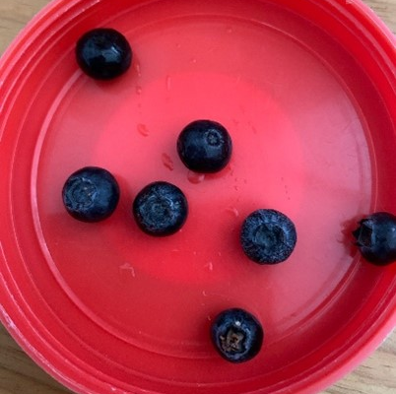
Subitising
Subitising is the ability to instantly recognise the number of objects in a small group without counting them.
For example:
Notes:
How many blueberries can you see? How do you know? What other numbers can you see?
Our aim is for each child to be fluent with their subertising as this is the foundations of number and will ensure a strong grasps of number patterns as they work through the school.

Slide 10
Drawing Club
A literacy approach by Greg Bottrill, uses storytelling and drawing as a framework to develop oracy and early writing skills.
Skills:
Imagination
Vocabularly development
Mark-making/writing
Conversation
Listening and attention
Notes:
Drawing club is amazing, every child enjoys it and looks forward to the sessions. Drawing club is a daily session at the beginning of the day. I will start by reading a story………. This is followed by vocabulary and actions which the children repeat and use within their story telling. They then draw a picture based on the theme… which is followed by a secret word and number.

Slide 11
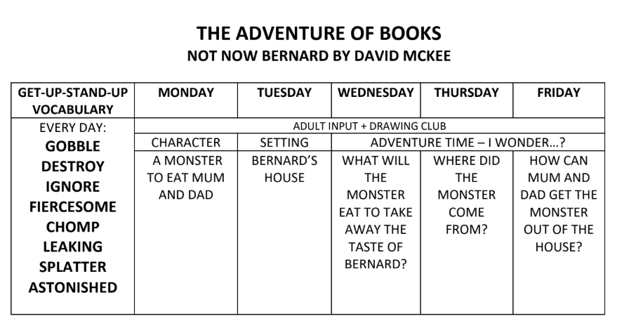

Slide 12
Discover and Learn
The Importance of Play
Play underpins the EYFS. It also underpins learning and all aspects of children’s development.
Through play children develop
  Language skills
  Emotional regulation
  Social skills
  Problem solving
  Creativity
  Exploring the world around them
  Awe and wonder
  Risk taking
  The list is endless
Play takes place indoors and outdoors.
Children have choice over their play.
Resources are always available.
Enhancements are added based on interests and next steps in learning.
Notes:
This speaks for itself. I am such an avocate for play and the importance of this enriching resource. Each day is different and the children lead the play, us adults facilitate this by prompting, suggesting and enhancing their play experiences.

Slide 13
Communication
We will always be on the gate during drop off and pick up.
  The mornings can busy and our main focus is settling the children. However, please let us know if it is something that will affect your child that day.
  After school is usually the best time to have a conversation should you need to.
Weekly Lambs Learning Letter
The Woodlea Word emailed
You can also contact the office by email info@woodleatlt.co.uk
Parent Consulation evenings
Annual written report
Notes:
However, be mindful, they are very busy people and would greatly love a reduce in emails and phone calls. Please read everything they have sent you the information is there!!! If I feel there is a need to communicate after school with you, I will contact you and either prewarn a meeting after school or a phone call at a more convenient time. My door is always open and a I am friendly and approachable!!
Is there a Whatsapp group chat up and running? Who is the classroom reps?

Slide 14
Any Questions…………..

