Slide 1

Meet the Teacher
September 2026
.
Welcome back!
We are very excited to be welcoming your children into Year 3 and are looking forward to a great year ahead!

Slide 2

The Year 3 Team
Class Teacher: Miss Maher
Mrs King (Monday PPA)
Teaching Assistant:
Mrs Andrew

Slide 3

Our School Values

Slide 4
School Day
Timings
In the morning, gates open at 8:35am for a soft start. Pupils go straight into class.
Please be aware children on site before 8:30am must be accompanied by a parent/carer.
Please make sure you do not enter the Junior Block in the morning!
If attending Brambles or a club before school, parents must take the children to the location of the club.
If someone different is picking your child up or you are running late, please let the office know via email or the phone and they will pass the message on to us.
We are still putting in place the good practice we started during the pandemic. We encourage the children to maintain good personal hygiene e.g. sneezing into their elbow, washing/ sanitising hands regularly.
If your child is unwell and not fit to come to school, please let the office know as soon as possible.
Things the children need
  Uniform & bags – small rucksack/bookbag
  Outdoor shoes
  Water bottle
  DO NOT NEED – toys, notebooks etc.

Slide 5
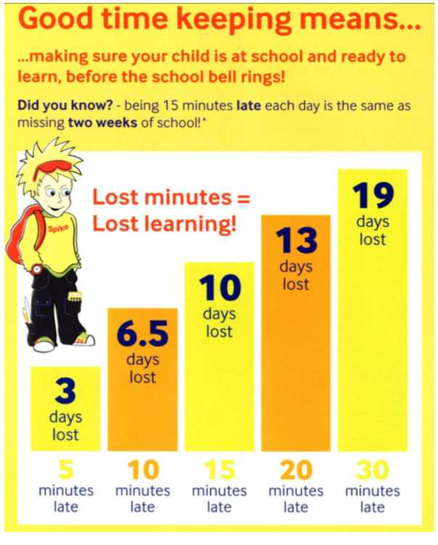
Being on time

Slide 6
Absence and Lateness procedures
Absence:
Parents are asked to inform the school of all absence on each day of absence by personal contact, letter, email or telephone.
Notification of the nature of the illness and the expected length of absence is also expected.
For medical or other appointments during the school day notification is required in advance, where possible these should be arranged out of school hours. Appointment cards/emails/texts must be shown to the school.
The office will make contact with the parent/carer of any child who is not in school for whom we have not received an absence message for by 9.15am.
Lateness:
Children who arrive late (after 8:50 but before 9:10) must report to the office.
If they arrive after 9:10 they should be accompanied by an adult to the office where they will be signed in.

Slide 7
Absence and Lateness
We understand that illness does occur, and events happen where you might run late, however the research is clear about the importance of attending school and being on time.
The pupils with the highest attainment at the end of key stage 2 and key stage 4 have higher rates of attendance over the key stage compared to those with the lowest attainment.

Slide 8
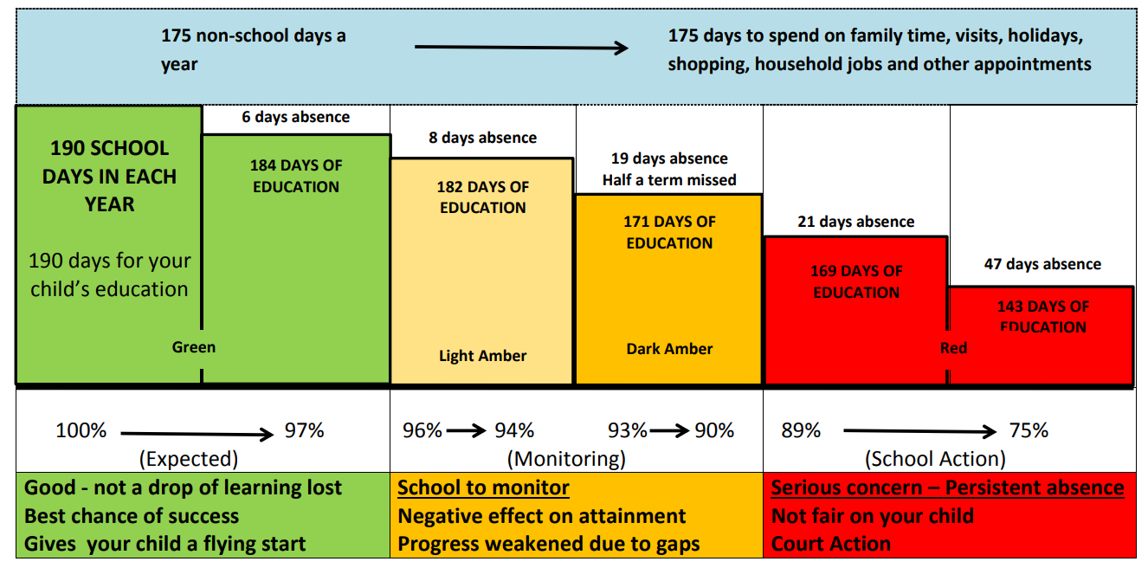

Slide 9
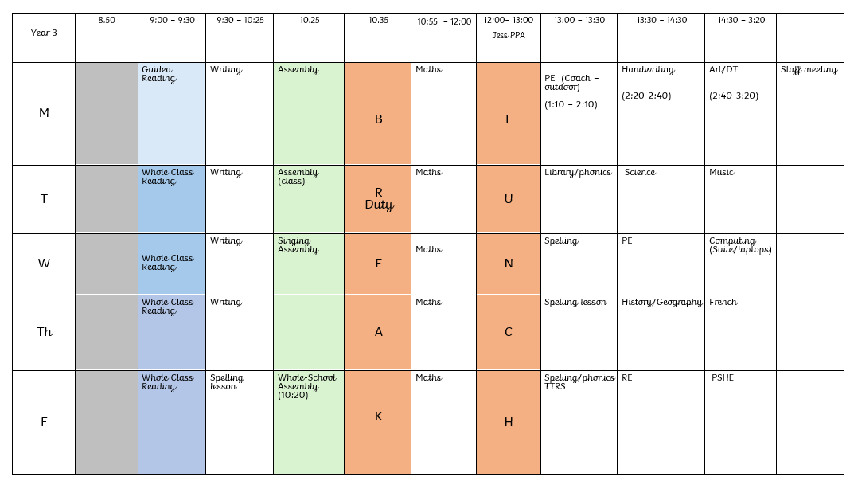
Curriculum & Enrichment Activities
Topics map /timetable:

Slide 10
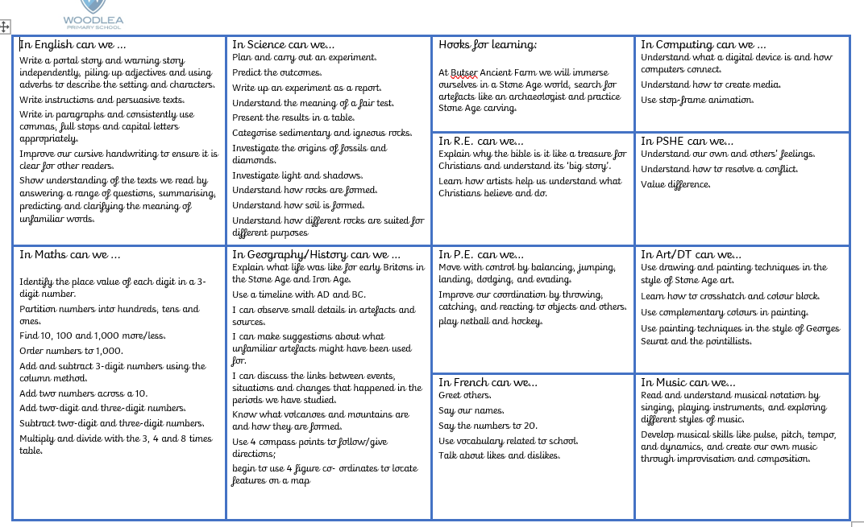

Slide 11
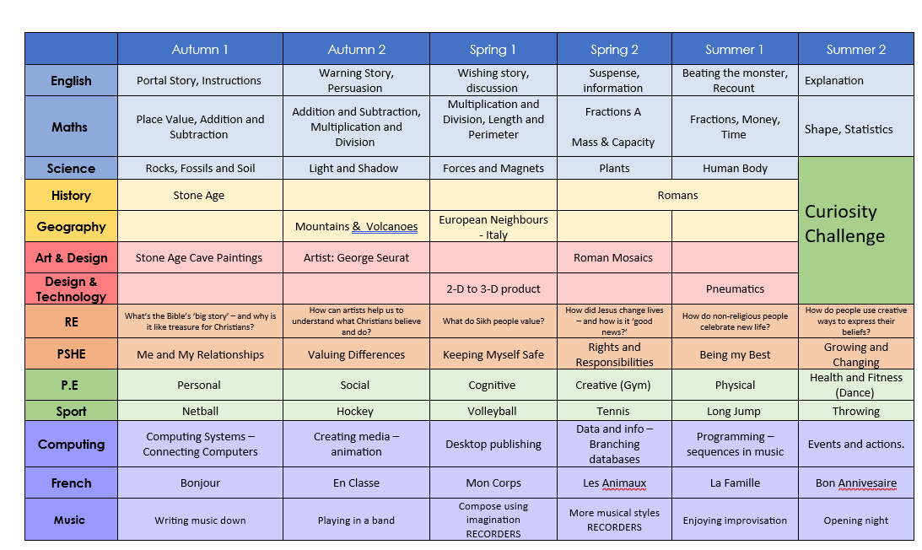

Slide 12

Curriculum & Enrichment Activities - Reading
We are currently reading George’s Marvellous Medicine
Show understanding of the texts we read by answering a range of questions, summarising, predicting and clarifying the meaning of unfamiliar words.

Slide 13
Curriculum & Enrichment Activities - Reading
At the end of the book:
• Did you like this book? Why? (Encourage children to develop their opinion about books by encouraging them to explain their reasons)
What was your favourite part? Why?
What was the most interesting/ exciting part of the book? Can you find it?
What sort of character was….?
Why did that character do … (give a situation/ event from the story)?
What happened in the story?
Questions to help reading at home.
Before reading the book:
• Can you point to the title? Or what is this? (Pointing to the title)
• What do you think this story will be about? What might happen in the story?
• What do we call the writing on the back of the book? (Blurb) or What does the blurb tell us?
During the reading of the book:
• What is happening in the pictures?
• What has happened so far? Is it what you expected to happen?
• What might happen next? How do you think the story might end?
• What sort of character is….? Is he/she friendly/ mean/nice…?

Slide 14
Curriculum – Guided Reading
Guided Reading will begin in Year 3 from Monday 21st September.
On this day, they will read and discuss a text with an adult in a small group and will be given their reading to complete at home.
Please continue to encourage your child to read regularly at home and record their reading in their blue Reading Record.
I will make sure the children know which day their Guided Reading session will take place and when their homework needs to be returned.

Slide 15

Curriculum & Enrichment Activities - Writing
we have focused on writing a story on the wordless book ‘Journey’ at the beginning of the term.
We are now focusing on Stone Age Boy.
Write a portal story and warning story independently, piling up adjectives and using adverbs to describe the setting and characters.
Write instructions and persuasive texts.
Write in paragraphs and consistently use commas, full stops and capital letters appropriately.
Improve our cursive handwriting to ensure it is clear for other readers.

Slide 16
Curriculum & Enrichment Activities - Maths
In Maths:
We still use White Rose Maths.
Identify the place value of each digit in a 3-digit number.
Flexibly partition numbers up to 1,000.
Partition numbers into hundreds, tens and units.
Add and subtract 3-digit numbers using the column method.
Add and subtract mentally.
Multiply and divide with the 3, 4 and 8 times table.

Slide 17

Communication
If you have a concern / worry / question we are here to listen.
As you know you can just email the school office to arrange a time to chat in person with the member of staff or arrange a meeting via teams: info@woodleatlt.co.uk
This helps us to:
  give you/ your child the time and focus you need.
  do any investigation which might be needed.
First port of call is always the class teacher unless it is feedback or a wider school concern and then a member of the senior leadership team should be referenced.
Please do give us time to respond as we are all teaching during the day.

Slide 18

PHSE & RSE
We use SCARF - Safety, Caring, Achievement, Resilience, Friendship
6 themed units:
1. Me and My Relationships: includes content on feelings, emotions, conflict resolution and friendships;
2. Valuing Difference: a focus on respectful relationships and British values;
3. Keeping Myself Safe: looking at keeping ourselves healthy and safe
4. Rights and Responsibilities: learning about money, living the wider world and the environment;
5. Being My Best: developing skills in keeping healthy, developing a growth mindset (resilience), goal setting and achievement;
6. Growing and Changing: finding out about the human body, the changes that take place from birth to old age and being safe.
The whole curriculum, including the resources are available on our website: Woodlea Primary School - PSHE and RSE Curriculum
Before the summer units (RSE units) we send out specific information and invite parents into discuss the curriculum and ask questions. There will also be workshops for parent in the summer term.
Notes:
We know the news around this area can leave parents concerned. Everything we teach is carefully planned and was worked on through working parties with Woodlea parents in the past. We are completely transparent.
PSHE lessons are taught by their class teacher once a week in their timetabled PSHE lesson, throughout the entire year in their usual classes, in mixed sex groupings, using a range of interactive teaching methods, e.g. activity sheets, films, songs, online games, and drama techniques.
To ensure that children feel comfortable to learn about a range of topics, we create a safe learning environment using a group agreement at the beginning of lessons or topics. This includes a confidentiality statement understood by adults and children. The teachers will also use a range of skills, including distancing techniques and the anonymous question box. Teachers will answer children’s questions factually and honestly in an age-appropriate way and respond to any disclosures following the schools safeguarding procedures/child protection policy which can be found on our website.
Ref: School Policy download.asp

Slide 19
Fidget Tools
Fidget Tools can be useful for some children who might have additional needs to support their attention and engagement in class.
An agreement will need to be entered between child, parents and teacher to set out clear expectations of the use of fidgets in class.
This agreement will cover
How to use a fidget in class and when
What will happen if it is not used appropriately
Expectations of completing work and engagement in lessons
Fidgets will be provided by school and kept at school to ensure they are used appropriately
A discussion about the type of sensory tool being used
This agreement needs to be understood and signed by the child, parent and teacher to ensure fidget tools do not become the barrier to learning, but support.
Notes:
Emphasise just noticing increase in requests. Voluntary slide if you feel needed.

Slide 20
Curriculum & Enrichment Activities
Trips
Butser Ancient Farm- focusing on the Stonge Age building- 19/11/2026
Special Days/Events- Roman Day- 23/04/2027

Slide 21
Home Learning
Reading
Children should aim to read for at least 15 minutes, four times a week. This can be a book they have borrowed from school or a book of their choice that they are enjoying at home.
Please record your child's reading in their Reading Record and ensure that it is signed by an appropriate adult. Reading Records will then be checked every Monday, so please make sure they are brought into school on this day.
Children will also be given a short reading activity to complete at home following their Guided Reading session; this will include some reading and written activity.
Spelling
We are currently using the CUSP Spelling scheme. Children will take part in three spelling lessons each week in school and will then be given a short home-learning activity to consolidate what they have been learning.
This will be sent home alongside their Guided Reading homework once our weekly Guided Reading day has been confirmed.
Times Tables
Children should practise their times tables for up to 25 minutes across the week. Times Tables Rock Stars (TTRS) is a great way for children to develop their recall and speed with number facts. We recommend breaking this practice into manageable 5–10 minute sessions throughout the week.

Slide 22
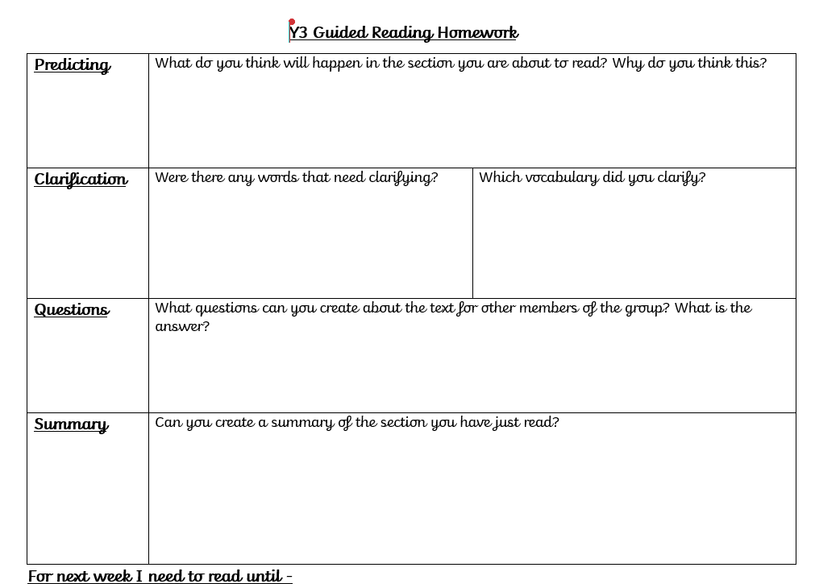

Slide 23
PE & Outdoors clothing
PE is on Monday (outdoor with coach!) and Wednesdays (indoor)
Clothing – Please ensure outdoor shoes can be put on independently and all clothing is labelled.
Please can you make sure if children have had their ears pierced that they are covered on PE days; we are not allowed to do this!
Teachers can’t tape for pupils and will retain the right to exclude a pupil from PE in any circumstances where they feel the pupil is at risk.
The use of retainers (flat studs that retain the piercing when earrings or studs are removed) can be used provided these are flat and cannot cause damage if a blow or ball hits the side of the head, the level of risk is clearly reduced. No jewellery, including studs are to be worn during PE!

Slide 24

Sponsored Walk – Monday 12th October
We are reviving a school tradition for raise funds but also explore the local area.
There will be three routes, one for Lambs (school grounds), and different ones for KS1 and KS2.
Children will be accompanied by school staff
We will be sending out letters with more info shortly.

Slide 25
Any Questions?

